Slide 1
IoT in Agriculture - Soil Moisture
And How sensors communicate with IoT Devices

Slide 2
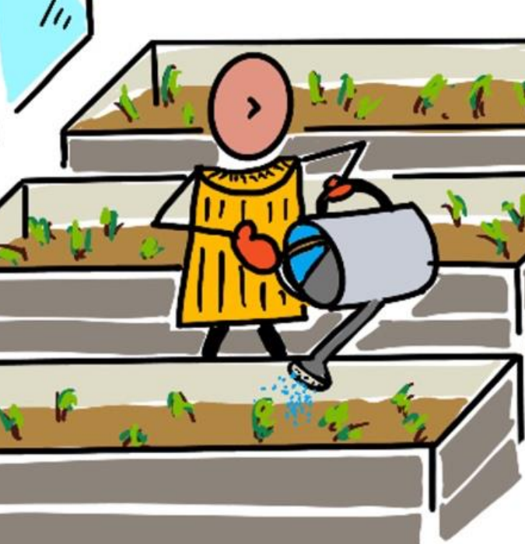
Intro
Last class we talked about ambient temperature
used it to switch on/off LED
Hard to control temperature (control environment using heaters etc)
Moisture is another ambient property
Easier to control(either with watering can or large scale irrigation system)
Agenda
Soil Moisture
How do sensors communicate with IoT devices?

Slide 3
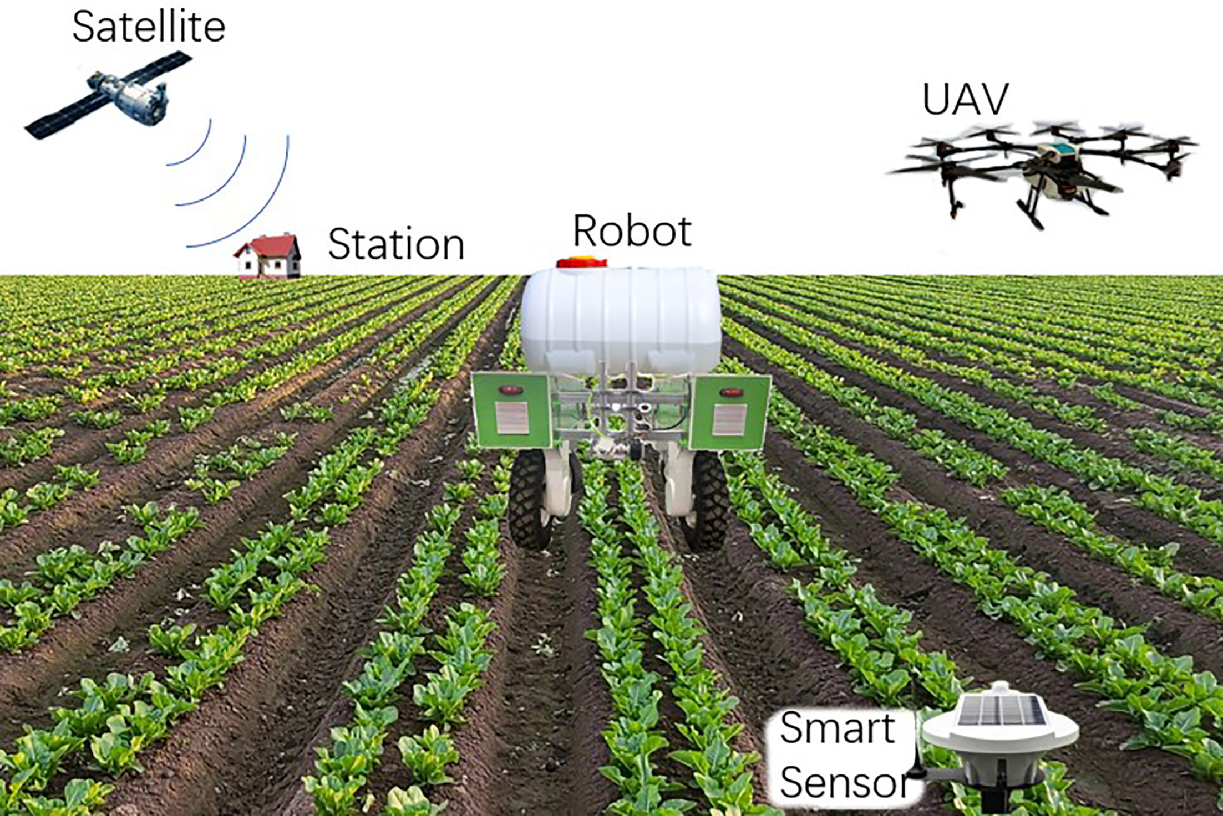
Digital Agriculture (Agri 4.0)
Digital agriculture uses tools to collect, store, and analyse farming data .
It is also known as the 'Fourth Agricultural Revolution' or 'Agriculture 4.0' .
It encompasses the entire 'agriculture value chain', from farm to table . This includes tracking produce quality, warehouse systems, and even tractor rental apps .
Digital agriculture allows farmers to increase yields, use less fertilizers and pesticides, and optimise water use .
'Precision Agriculture' is a technique that observes, measures, and responds to crops on a per-field basis .
This Photo by Unknown Author is licensed under CC BY

Slide 4

Agri 4.0 Use Cases
Temperature measurement - to predict plant growth and maturity .
Automated watering - using soil moisture sensors to water only when needed .
Pest control - using cameras on robots or drones to apply pesticides only where needed .

Slide 5
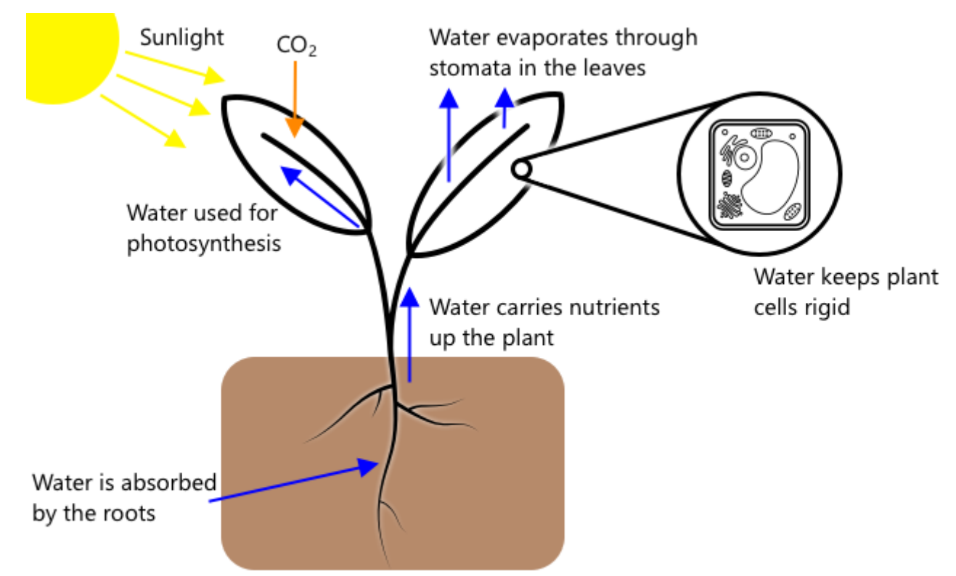
Soil Moisture
Water Uptake:
Plants absorb water through their roots, which is essential for growth.
Key Functions:
- Photosynthesis: Combines water, carbon dioxide, and light to produce carbohydrates and oxygen.
- Transpiration: Water loss through leaf pores helps draw in CO₂, transports nutrients, and cools the plant. Approximately 90–98% of water absorbed can be lost through transpiration.
- Structural Support: With plants being about 90% water, moisture maintains cell rigidity and overall structure.

Slide 6
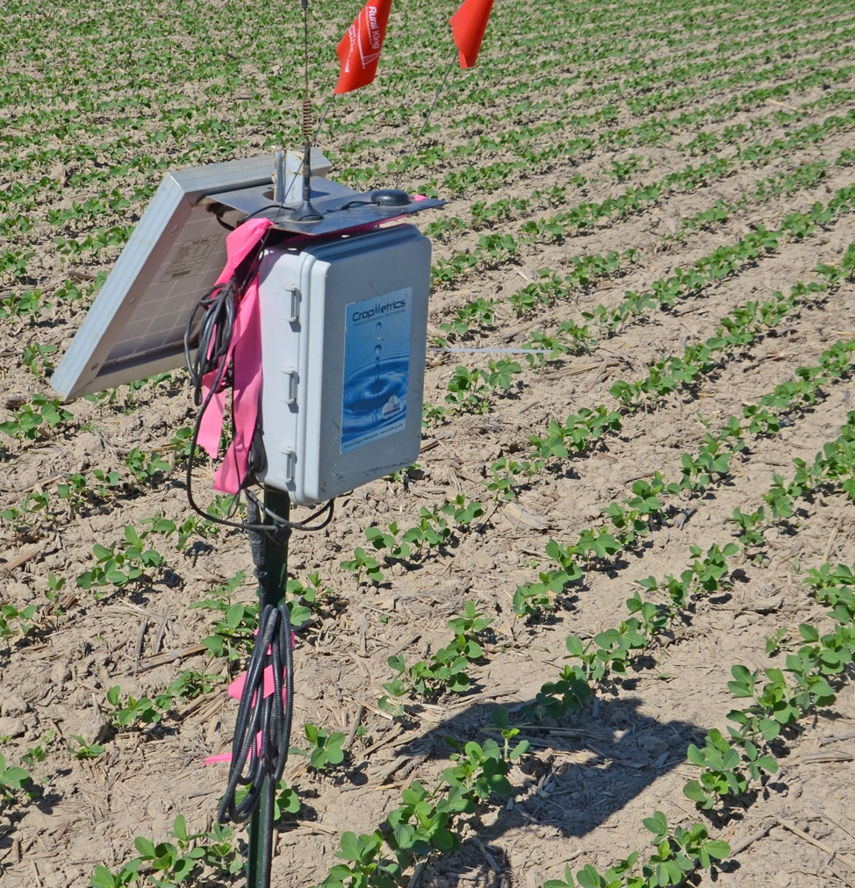
Why monitor Soil Moisture
Optimal Conditions:
Ideal soil moisture levels are crucial; too little water restricts nutrient absorption, while too much leads to root oxygen deficiency and decay.
Impact on Plant Health:
Balanced moisture ensures healthy root function and supports overall plant vitality.
IoT devices help farmers monitor soil moisture in real time, ensuring watering only when necessary.

Slide 7
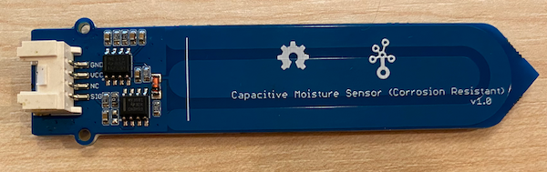
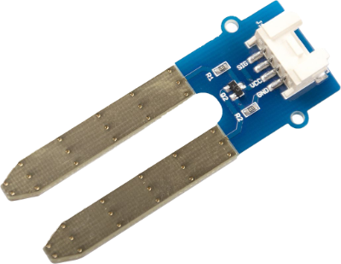
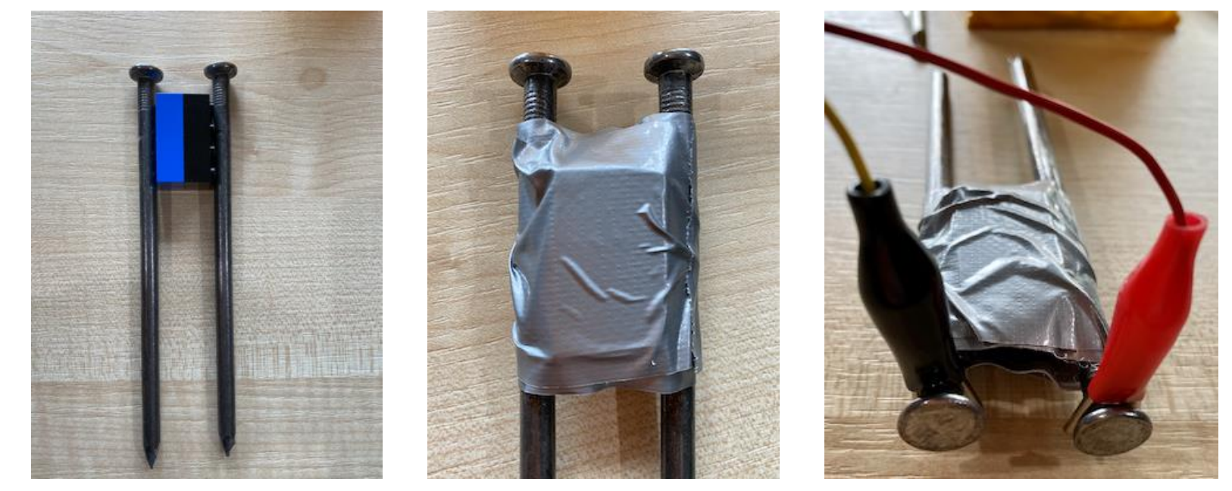
Soil Moisture Sensors
Resistive Sensors:
Use two metal probes to measure electrical resistance in the soil.
Higher water content lowers resistance, providing an indicator of moisture levels.
Can be built simply (e.g., using two nails and a multimeter).
Capacitive Sensors:
Measure changes in capacitance between electrical plates due to varying soil moisture.
Convert these changes into a measurable voltage for IoT devices.
Common Output:
Both sensor types produce an analog voltage that reflects soil moisture levels for further digital processing.

